Slide 1
Capstone Project on Pneumonia Detection
AIML – JUL 21A-GROUP 6-CV1

Slide 2
Team members- 1. Ashish Tiwari 2. Kanishk Sanger 3. Ninad Mahajan 4. Avinash Kumra Sharma 5. Tushar Bisht Mentor- Mr. Rohit Raj

Slide 3
Roles and Responsibilities-
We have divided the project task with each team members as per their roles. There responsibilities are given below-
1. Ashish Tiwari-
Ashish has downloaded the data from Kaggle API’s. he has done preprocessing of Data. checked the performance of different models on the data and selected the final model on the basis of accuracy.
2. Ninad and Kanishk –
Ninad and Kanish are responsible for model deployment on production.
3. Avinash and Tushar –
They are openly working with each team members and contributing in the project.

Slide 4
Backstory – Pneumonia Study
Introduction to Project
What is Pneumonia?
Whom does it effect?
Types of Pneumonia
How is it diagnosed?
Why should we be concerned?
Problem Statement
Need of the study / project
Business / social opportunity

Slide 5
Data Report Data Source - study conducted by NIH Clinical Center, Maryland, USA
Data collected : frequency
Data collected : time
Data collected : methodology
112,120 frontal-view X-ray
51,708 with known pathologies
Subset of this is used in this project
30,227 unique patients
Time period 1992 - 2015
Image
Dicom – 1024 * 1024
B-box
Radiologist identified
Labeling
NLP techniques

Slide 6





Part of data report
Dataset : Kaggle RSNA Pneumonia detection challenge
https://www.kaggle.com/c/rsna-pneumonia-detection-challenge/data.
Structure :
Folder 1 : Train Images (26,684)
Folder 2 : Test Images (3000)
CSV File 1 : Train Images Bbox info
CSV File 2 : Train Images Target class info

Slide 7
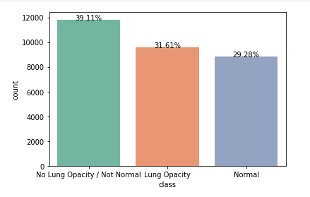
EDA and Data Pre-processing :
Combined both CSV info into one Data frame
Dropped Duplicate Patient info
Descriptive Analysis - DICOM metadata
Converted images from DCM to PNG
Distribution of Target Classes

Slide 8
Modeling
Define Data Generator
Define custom Loss function
Create, Compile, Fit, Evaluate and Predict Model
UNET VGG16
Mask RCNN
Optimizer – Adam
Metric – Mean IOU, IOU Loss, Precision/Recall, F1 score

Slide 9
Comparison of Models, Benchmarking and Visualization-
Approach to select final model based on outcomes-
We ran hyper parameter tuning for the two models UNet VGG16 and MASK RCNN. Below we describe more details on the model execution and its evaluation.

Slide 10
UNet VGG16 :
Following are the predictions for the top 3 chosen hyper parameter combinations of UNet VGG16
From the results captured in the above table, we have the best model performance with a mean IOU of 0.808 and an F1 score of 0.621 when below hyper parameters are selected.
• Freeze layers = 13
• optimizer = Adam
• LR = 0.005
• batch size = 64
• epoch = 10

Slide 11
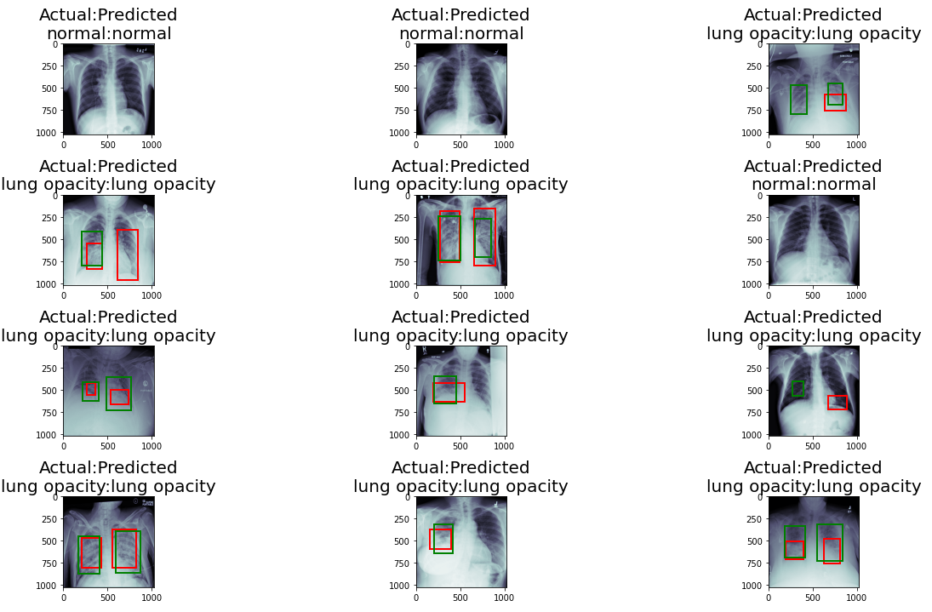

Slide 12
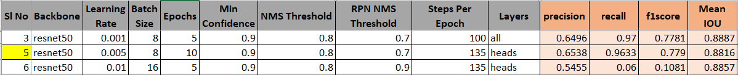
MASK RCNN:
From the top 3 best performing model with the chosen hyper parameter combinations, we calculated Precision/Recall and F1 scores.
Based on the evaluation, the hyper parameter combinations in 5th row had resulted in high Precision, Recall and F1 score which are 0.651, 0.95 and 0.772 respectively. Hence, we choose this as our best model for MASK RCNN and following are the corresponding hyper parameter values.
• backbone = resnet50
• learning_rate = 0.005
• batch_size = 8
• epochs = 10
• det_min_conf = 0.9
• det_nms_th = 0.8
• rpn_nms_th = 0.7 • steps_per_epoch = 135 • layers = heads

Slide 13
Model Evaluation-
On evaluating the models, we observe that Mean IOU for MASK RCNN is 0.90 which is higher than UNet VGG16 whose mean IOU is 0.81. The precision, recall and f1 score for UNet VGG16 are 0.59, 0.66 and 0.62 respectively and compared to MASK RCNN, Mask RCNN has high recall of 0.90 and a precision of 0.71 with an f1 score is 0.78. The recall is high which means the model is able to predict most of the positive samples (both opacity and normal samples) correctly, however, the precision is low which indicates the true positive samples of all the positive samples is low. And the F1 score is also very high compared to the UNet VGG16 model.
Best Model:
From the above comparison results we can clearly say MASK RCNN out performed UNet VGG16 and hence selected as the BEST model.

Slide 14
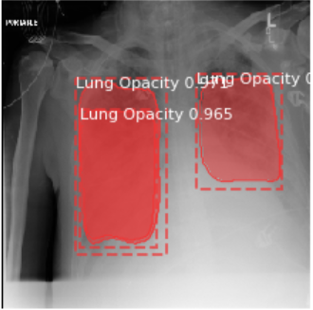
Results
Mean IOU : 90.09%
Recommendations :
Less noisy dataset
More labeled data
Image augmentation
Balance the classes
Different parameters & values

Slide 15
Model deployment-
As we know that Flask enables us to create web applications very easily.
DIRECTORY STRUCTURE
First let’s have a look at our directory structure, this will give us a broader picture of the overall project and it is also useful to know it when you working with flask, I have saved the project under a main directory called ’deployment files’.
Requirement-
For deployment, we have imported some necessary libraries. which is given below-
Flask==1.1.2, keras==2.9.0 ,matplotlib, numpy,opencv, python_headless, pandas, Pillow==9.2.0, pydicom==2.3.0, scikit-image, scikit-learn,
seaborn, tensorflow==2.9.1

Slide 16
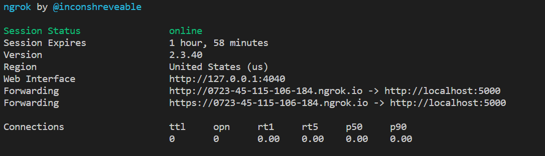
DEPLOYMENT and OUTPUT :
Now let us have a look at the final result, how everything looks like once we deployed it, first we deployed it in my local machine and later we will deploy it in a public server.

Slide 17
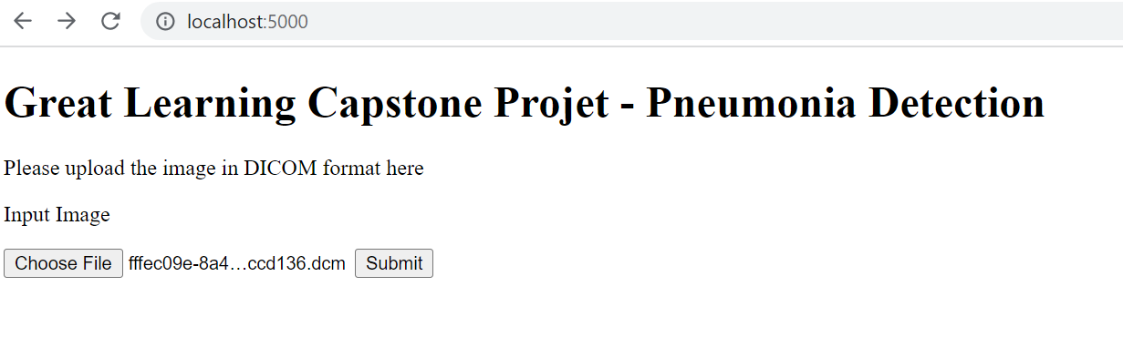
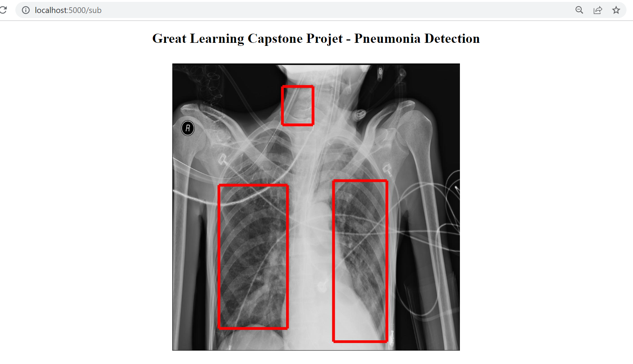
Final Output:

Slide 18
Limitations of our solution-
The input data that was provided is challenging one to predict as all the images are similar. It was tough to differentiate between opacity and normal dataset.
Team had a short time working on different CV models, comparing the time taking on the SOTA models. Model consumes a lot of resources (GPU) and executions take longer time. To ensure we complete the model creation, we considered 2000 images for training, 500 for validation and inference.
While using the MASK RCNN model, we find it tough to look for the right GitHub repository and the appropriate mapping of TensorFlow/Keras version. It didn’t work on Google Collab due to its nature of use of latest software versions. We chose to work on Kaggle to overcome this limitation, that provides the ability to select the versions of the software needed to build and train the model
As part of MASK RCNN training, the predictions are not coming correct even though the mean IOU is above 0.85. When we made a closure look, we identified that the model is predicting all images irrespective of the opacity or sometimes they are not predicting at all. Thus we had to change the data selection technique (negative sampling where we choose opacity as our main data and include negative samples with normal label data), preprocessing methods (data augmentation technique to restrict rotations, flips to horizontal) etc., for the model and adopt similar things for other models as well.

Slide 19
Suggested Improvements :
Dataset selection can be improved, by trying with different combinations
Pre-processing can be improved, by trying with different image shapes
Model training with different hyper parameters and values

Slide 20
Our Learnings :
Had an excellent opportunity to learn Computer Vision with SOTA models.
Learned and used state of art models like UNet, MASK RCNN, YOLO V3 along with Transfer learning approach.
Adopt different visualization techniques like line charts, bar charts, parallel coordinates, loading and displaying dicom images with bounding box representation.
Handling imbalanced data and its implication, by adopting Negative sampling, using data augmentation technique (Albumentations, imgaug) and generating more opacity images.
Use of other external tools like Weights and Biases to train models with defined hyper parameter values, and visualize data of model parameter executions.
It has helped to look and gain awareness on the SOTA models like MASK RCNN, YOLO V3, SSD

Slide 21
Final Note :
Many thanks to our Mentor – Mr. Rohit Raj for his expert guidance for completing this Capstone Project
Thanks to our Program Manager – Mugdha Deepala for her dedication and support in conducting AIML program smoothly as scheduled
Finally, Thanks to Great Learning for offering this wonderful AIML course

